Slide 1

APB: Aidan’s (Alternate) Path to Braille and Literacy
TAER 2017
Sherry Airhart, TVI, Frenship ISD
and
Ann Adkins, TSBVI Outreach Program

Slide 2
“If a child can’t learn the way we teach,
Maybe we should teach the way they learn.”
Ignacio Estrada
Notes:
This quote sums up APB!

Slide 3
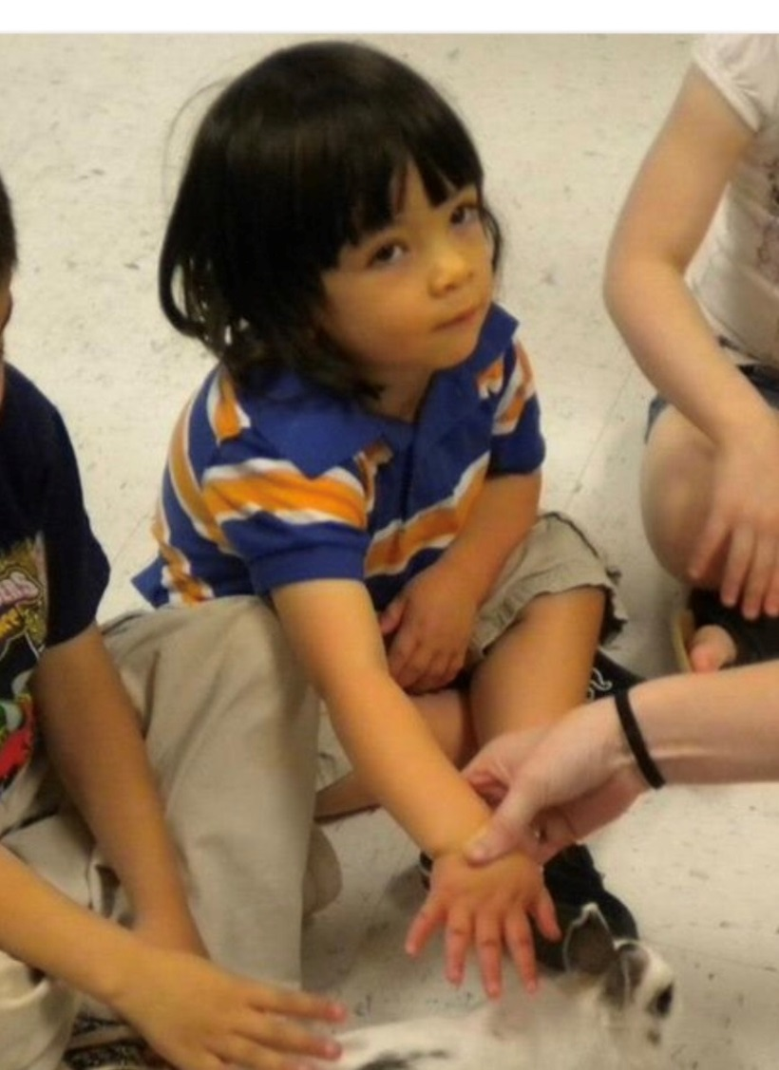
Aidan
Born: 2/8/08 (9 years old)
Bennett Elementary in Frenship ISD
TVI: Sherry Airhart
COMS: Steve Boothe, Region 17 ESC
Parents: Greg & Stephanie Noyola

Slide 4
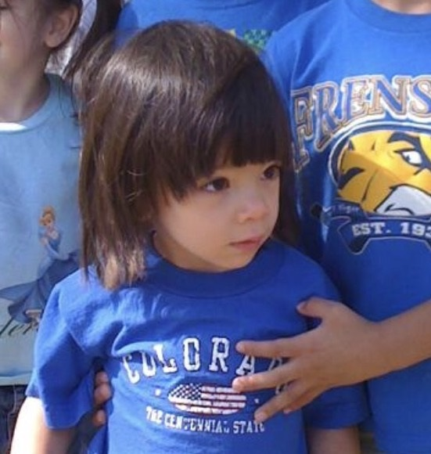
Aidan
Etiology & Medical Conditions
ONH/SOD
Absence of septum pellucidum
Hypoplasia of corpus callosum
Panhypopituitarism – pituitary hormones reduced
Hypothyroidism

Slide 5
Impact of Eye Condition & Medical Problems
No vision (NIL)
Coordination problems & hormone deficiencies (result of absence of septum pellucidum & panhypopituitarism)
Low cortisol levels
Needs growth shots & meds for thyroid
Can affect integration of motor, sensory, & cognitive information between cerebral hemispheres
Notes:
Show early videos – walking in hall

Slide 6
Impact of Medical Issues (continued)
Began talking around 3 years old; echolalic
Was not walking when entered PPCD; carried a lot; walked w/ support at 4
Lots of sensory issues – liked swinging, cuddling, being in a closet, having a blanket; also beat on his chest, tapped his teeth
Dislikes shirts with buttons, tags, collars
Eating issues – didn’t eat solid foods, didn’t chew, only liked soft, mushy foods; this is still true
Need for additional processing time
Notes:
Still likes cuddling & hugging
Show videos – at home

Slide 7
Impact of Medical Issues (continued)
Very low tone – difficulty w/ both gross & fine motor skills
Very poor balance; wobbled when he walked
Did not try to interact with other students, but did sometimes ask teacher what other students were doing
Difficulty w/ change; needs more time for transitions
Difficulty attending; seemed “disconnected” from things and people around him; “in his own world”

Slide 8
Impact on Tactile Skills & Braille
Difficulty w/ fine motor skills
Couldn’t use both hands together in purposeful ways (only beating on his chest)
Poor finger & hand strength – difficult to push keys on braille writer
Problems w/ identifying, spreading, wiggling, isolating fingers, especially using his thumbs
Coordination problems; double-jointed
Notes:
How might these issue affect braille reading & writing?
Show early braille videos
Show early videos of Aidan

Slide 9
Materials & Strategies for Aidan
Concept Development
  EVALS Kit – “Beginning Concepts” checklist
  Concept books
  Identifying, matching and sorting meaningful objects
  Object books - about family, anything to include music, object books using nursery rhymes
Notes:
Things Sherry did w/ Aidan…evolution of APB

Slide 10
Materials & Strategies for Aidan
Sensory, Tactile & Other Pre-Braille skills
  EVALS Kit – “Braille: PreBraille” checklist
  EVALS Kit - “Tactile Graphics Skills for Math” checklists
  Hierarchy of Tactile Skills
  OT consult
  Motor skills (COMS from ESC 17)
  1-to-1 correspondence
Notes:
More things Sherry did w/ Aidan…also information from Outreach, Lisa Ricketts, & ESC 17

Slide 11
Materials & Strategies for Aidan
Emergent Literacy
  More nursery rhymes, rhythms, music
  Whole event experiences - walking him through the whole process of the activity
  Simple alphabet books focusing on one letter at a time
  Whole language approach using stories about his family and everyday life events
  Listening activities
  Listening to AR books and taking tests
Notes:
Describe how he took AR tests; using his auditory strengths

Slide 12
Materials & Strategies for Aidan
Beginning Braille
  Tactile Treasures
  Touch and Tell
    Building on Patterns
    First line books
    Setting the Stage
  Popsicle sticks
  Lego Braille cells
  Perkins Brailler; Mountbatten
  Velcro bead braille cells, muffin pan, egg cartons, tennis balls, different enlarged braille cells using various textures, pop a cells,
  Braille alphabet cards w/ objects & braille letters
  Many different OT activities for finger & hand strength
  Creating his own stories by “brailling” & “reading” them
Notes:
Explain/show popsicle sticks
Other???

Slide 13


APB – Aidan’s (Alternate) Path to Braille & Literacy
Student-centered approach
Thinking outside the box
Flexible
Individualized
Interest-based = motivating to HIM
Taking an alternate route
Evolving!
Notes:
Result of Sherry’s innovative methods is…APB

Slide 14
APB – Aidan’s (Alternate) Path to Braille & Literacy
“Sherry invented a texture system that has unlocked something in Aidan's brain! He is actually comprehending the meaning of reading now.” (Aidan’s mom)
Notes:
Share quotes & videos from Aidan’s parents, teachers, & VI Consultant at Region 17 ESC (letter from Steve; text from mom)
Sherry never gave up – kept searching for a way that met Aidan’s very specific needs. And it works…
Show photos & videos

Slide 15
APB – Aidan’s (Alternate) Path to Braille & Literacy
“Sherry's system has changed Aidan's world!”
Greg & Stephanie Noyola, Parents
Steve Boothe, COMS
Notes:
Opened a new world to him (parents) & provided him a way to develop many early literacy skills
Quote from both parents & COMS
Impact on other areas – not just literacy. Changed everything! Unlocked his world! Notice in slides & videos:
More focused
More attentive
More involved in learning & activities around him
Better posture
Improved motor & O&M skills
More motivated to learn; asks for textured books & materials
Participates in grade level activities

Slide 16
Additional Information & Issues
Not started as a system to replace braille but as “an opportunity to gain the concepts of reading & writing”
Introduction of a “Pre-Braille Tactile System” (COMS)
Issue of 1-1 correspondence
Tactile & sensory issues
Lack of processing skills
Why it worked & traditional materials & methods didn’t???
Notes:
But there have been some questions & concerns; other issues that needed to be addressed.

Slide 17
Sherry’s Suggestions
Being willing to try “whatever works”
Emphasis on student’s strengths & how he learns – not on what he can’t do
Don’t be afraid to ask for help!
Importance of administrative support & working with other teachers, parents, & support staff
Look for different solutions

Slide 18
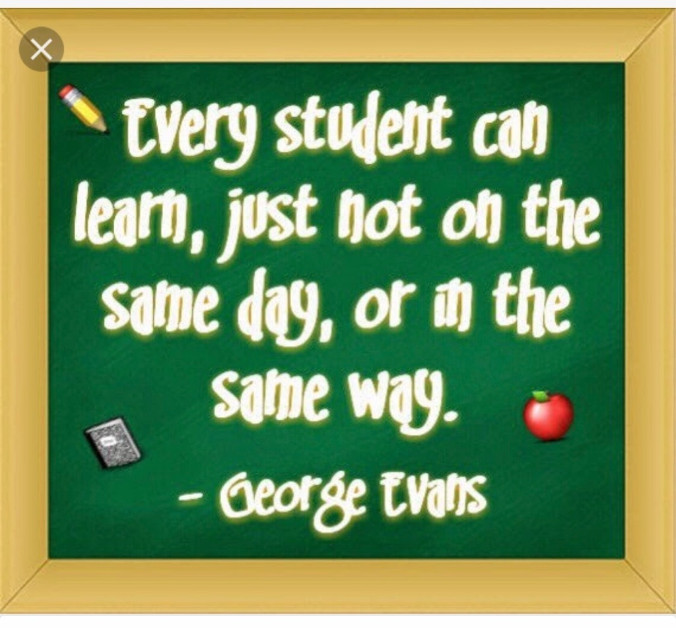
Notes:
Remember the original quote? “If a child can’t learn the way we teach, maybe we should teach the way they learn”
Think about that along w/ the next 3 slides…

Slide 19
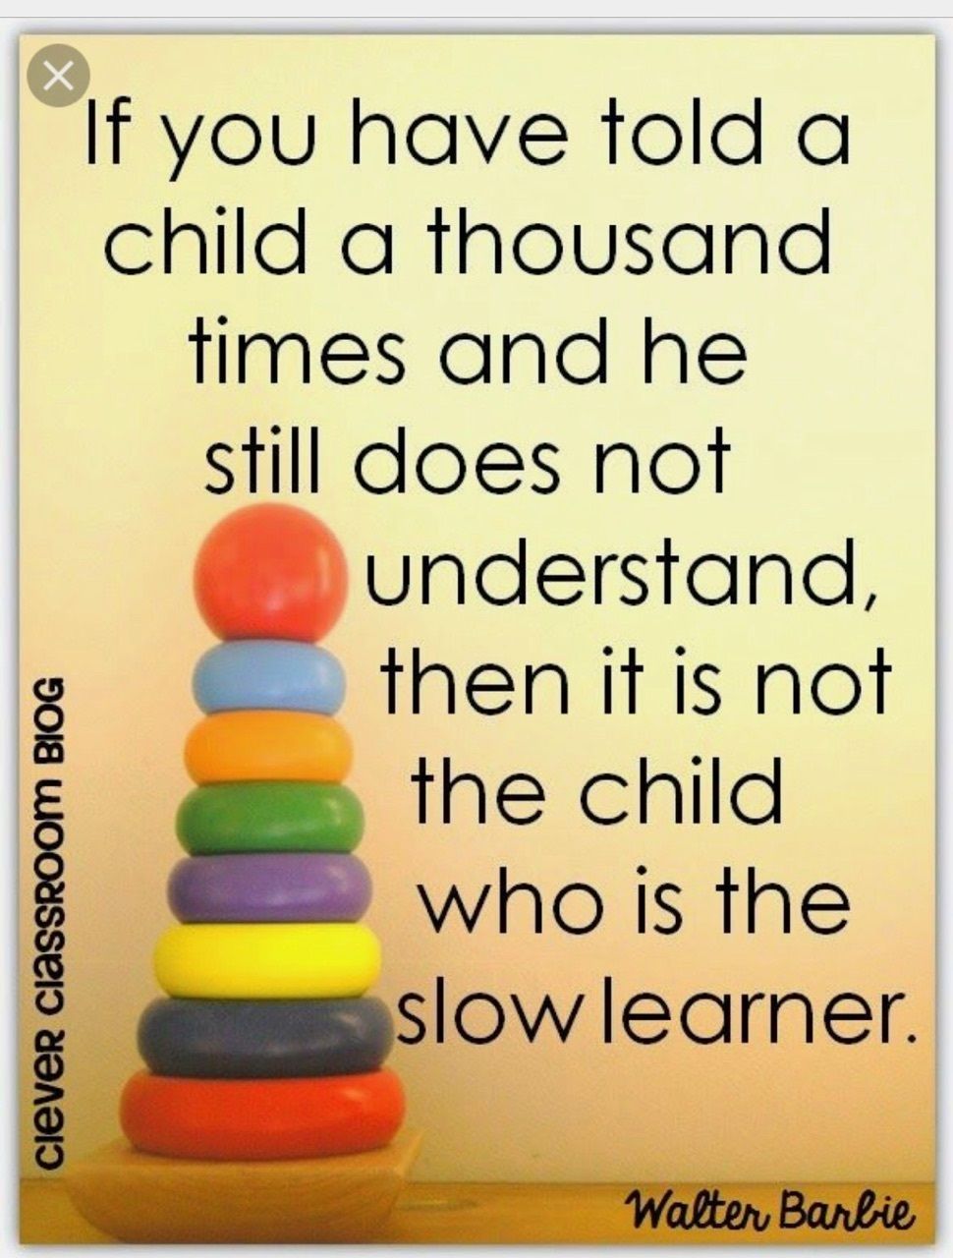

Slide 20

Notes:
Sherry has been Aidan’s CHAMPION. This sums up Sherry’s philosophy & APB. Encourage each of participants to be the champions of their students…
We know that teachers make the difference! True not just in reading & literacy skills, but in a child’s ability to access and participate in the world.
Quote from National Reading Association on importance of teachers…?

Slide 21
Contact Information
Sherry Airhart, Teacher of the Visually Impaired: sherryairhart@gmail.com
Ann Adkins, Education Specialist, TSBVI Outreach Program: adkinsa@tsbvi.edu

